Slide 1
Lecture 1: Software Quality, Verification, and Validation
Gregory Gay
DIT636/DAT560 - January 19, 2026

Slide 2
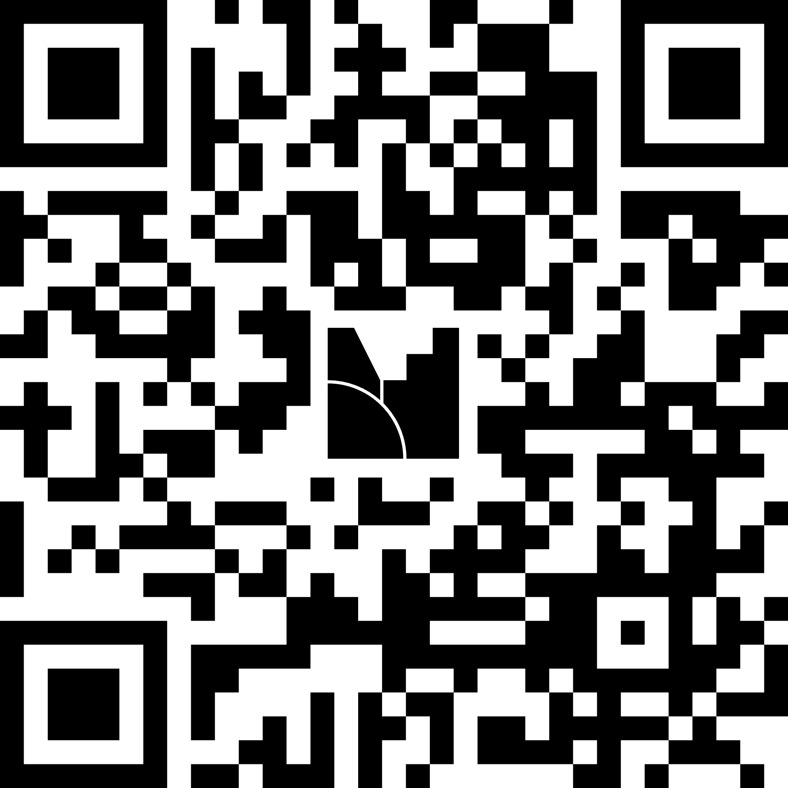
When is software ready for release?
menti.com, code 5493 1979
Notes:
Just start with a question - want you to start thinking about this. Go to menti.com and use the code, then just give an opinion if you have one.
This isn’t something with one answer, or even a right answer. It’s something we’ll keep returning to

Slide 3
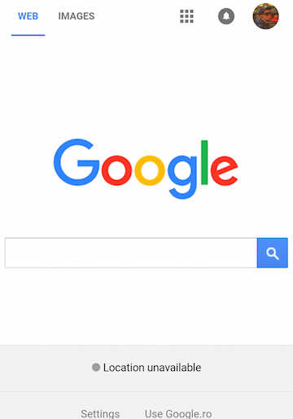
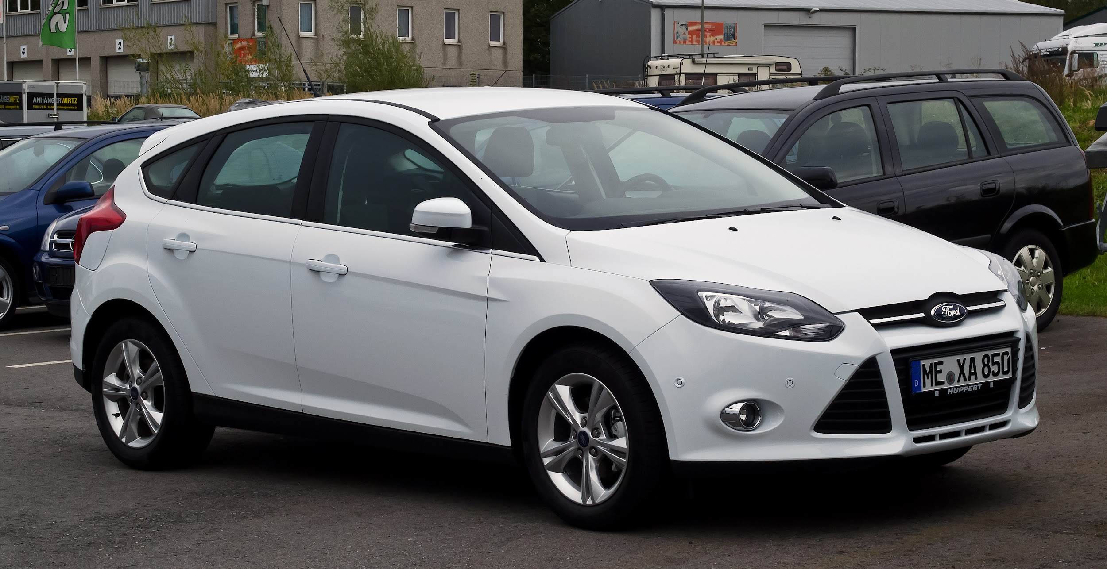
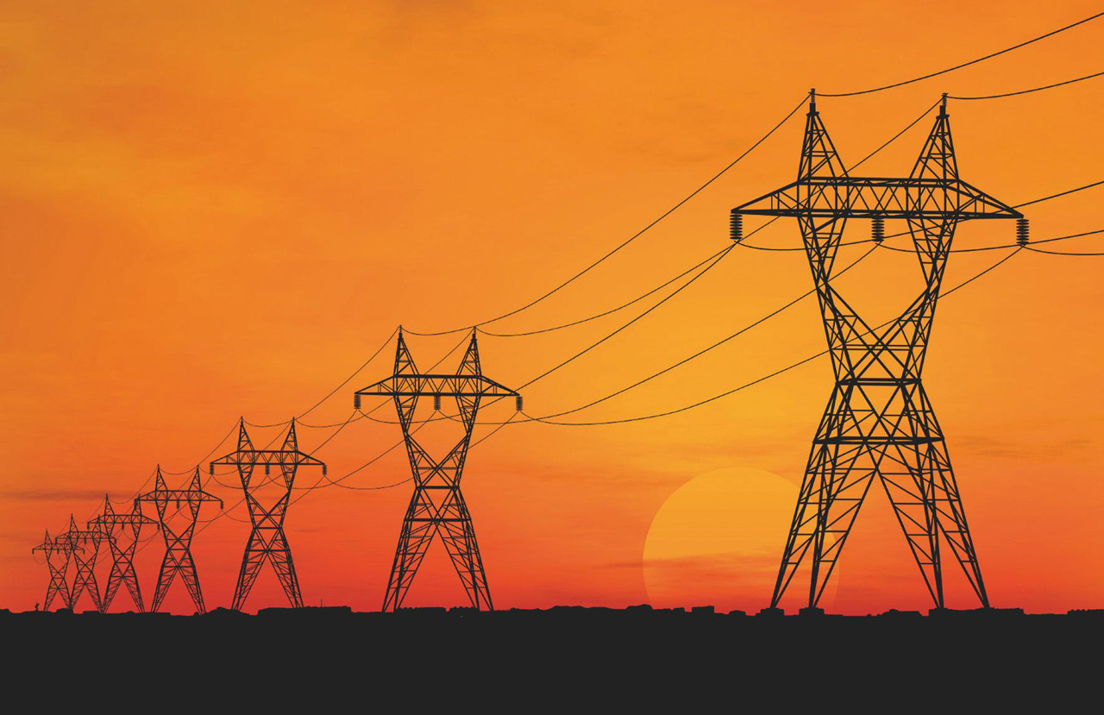
Our Society Depends on Software
This is software: So is this:
Also, this:
Notes:
Chrome, of course, is software. Excel or Word is software. No one disputes that. If I ask you about software, you’d mention something like this - a web app, a video game, a word processor. That’s not all that is software though - Our society is built on software. It powers our homes, it manages our private information, it controls our cars, it automates our factories and it even regulates our bodies. Ford is one of the largest software makers in the country. It is incredibly important that we construct good software. We need robust, operational systems, especially given growing demand for features, limited development budgets and strict time constraints.

Slide 4
Flawed Software Will Hurt Profits
2002: “Bugs cost the U.S. economy $60 billion annually… and testing would relieve one-third of the cost.” (NIST)
“In 2016, that number jumped to $1.1 trillion” (Cohane)
“Finding and ﬁxing a software problem after delivery is often 100 times more expensive than ﬁnding and ﬁxing it before.” (Barry Boehm (USC))
Notes:
If you screw up during design, development, or testing - if you release bad software...software bugs hurt your bottom line. They are expensive to fix, and only become more expensive the longer they remain active. The cost of fixing bugs, handling tech support, distributing the patched software, and addressing potential legal issues is not insignificant. In 2002, a study commissioned by the US Department of Commerce' National Institute of Standards and Technology concluded that "software bugs, or errors, are so prevalent and so detrimental that they cost the US economy an estimated $59 billion annually, or about 0.6 percent of the gross domestic product" The report estimated that minor improvements in software testing would relieve 1/3rd of that cost. By 2016, that had jumped to 1.1 trillion dollars due the incredible growth in the capabilities and importance of software.

Slide 5
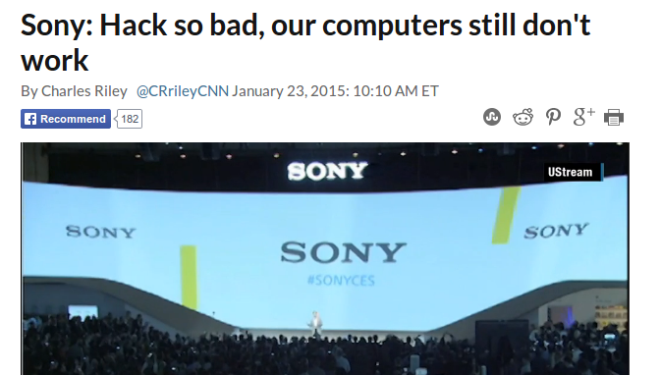
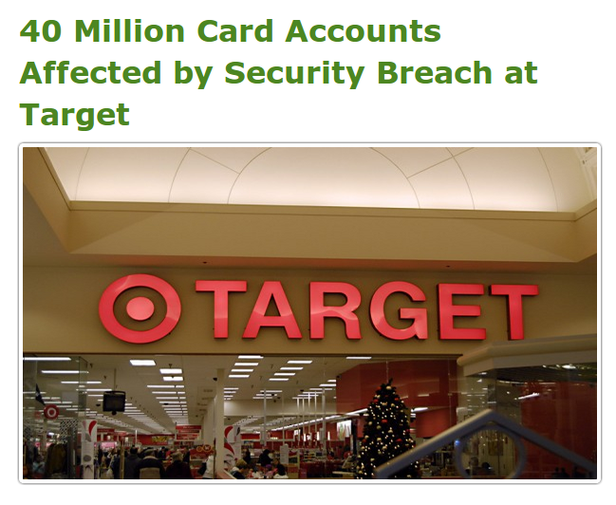
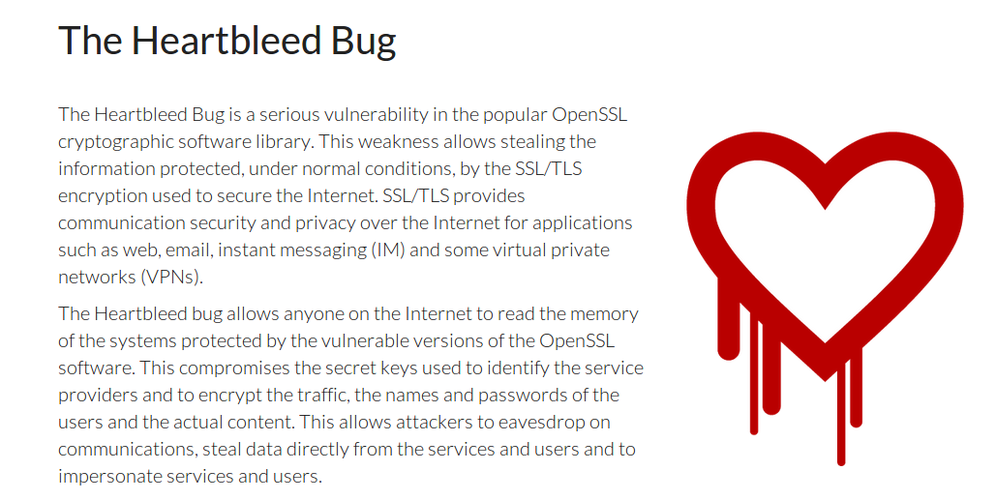
Flawed Software Will Be Exploited
Notes:
If your software is flawed, if you take short-cuts, if you don’t take security seriously, or if you don’t take the time to test your system, your flaws will be exploited. No matter how big or small you are, there are hackers working to find holes in your security, software defects they can take advantage of. You constantly see headlines about security breaches leading to leaked credit cards, or the secret documents of corporations and governments being leaked to the world. Even the software we assume is safe, the open-source code powering the modern internet, is being cracked. Now, some of this is in the realm of security, but how you develop software matters. It may take some time, but, as a developer, improper engineering efforts will cost you. As expensive as it may be, as time consuming, to produce robust software, not taking proper engineering seriously will cost you - the loss in profit or reputation may easily outweigh the savings from releasing early.

Slide 6
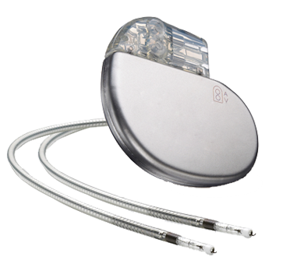
Flawed Software Will Hurt People
In 2010, software faults were responsible for 26% of medical device recalls.
2011-2015: 627 devices (1.4 million units) recalled, 12 devices (191K units) in “highest-risk” category.
“There is a reasonable probability that use of these products will cause serious adverse health consequences or death.”
US Food and Drug Administration
Notes:
Security breaches are bad - they can cripple financial instruments, they expose users to identity theft, but those are a drop in the bucket compared to the full extent of how much software can effect your life.
This little device, fits in the palm of my hand, is a pacemaker. A little block of sensors, pulse generators, and a lot of complicated software, that regulates the beating of the heart. Just one example of the growing medical device industry - little complex combinations of hardware/software that are implanted in patients and used to improve their quality of life. In 2010, software problems were responsible for 26% of medical device recalls. In the four years after, a further 1.4 million units 04 627 unique devices were recalled, with about 200K of those (12 devices) in the highest-risk category. These were classified by FDA as class 1 recalls, meaning (quote).
To swap one of these devices, to remove a defective one, a patient must undergo surgery - a life-threatening operation in order to fix a software issue.
This is just a single example. Software has been at fault in rocket explosions, helicopter crashes, radiation overdoses, plant failures, and more.

Slide 7
This Course
What is “good” software?
Determined using quality attributes
(dependability, performance, scalability, availability, ...)
How do we show it is “good”?
Verification and Validation
Process containing testing and analysis activities.
Notes:
That is where this course comes into play. How do we delivery good software? How do we avoid flawed software?
In the first place (1) In other words, How do we assess quality? (2) So, the key to delivering robust , high-quality, software is through a thorough process known as v&v - verification and validation.
This essentially asks two things: Does the software do what we promised? Does the software meet the needs of its users?
In this course, we will explore the process of software verification and examine a variety of methods to test systems, prove their correctness, and make an argument that the software we build is reliable, dependable, and safe to use

Slide 8
Today’s Goals
Introduce The Class
AKA: What the heck is going on?
Go over course PM
Clarify expectations
Assignments/grading
Answer any questions
Introduce the idea of “quality”
Cover the basics of verification and validation

Slide 9
Contact Details
Instructor: Greg Gay (Dr., Professor, $#*%)
E-mail: ggay@chalmers.se
Website:
https://chalmers.instructure.com/courses/38208
https://greg4cr.github.io/courses/spring26dit636
Notes:
2nd link is a Backup of Canvas page/course materials.
May be out of date, but good if Canvas isn’t working or for after the course ends, permanent access to material

Slide 10
Teaching Team
Teaching Assistants
Lirong “Esme” Yi (lirongy@chalmers.se)
Lialia Beniaminova (gusbeniali@student.gu.se)
Zhuangzhuang Gong (gongzhuangzhuang928@gmail.com)
Vasilena Karaivanova (gusvasika@student.gu.se)
Maksym Matsuhyria (gusmaksyma@student.gu.se)
Ionel Pop (guspopio@student.gu.se)
Rohma Wajid Rasul (rohmawajidrasul@gmail.com)
Student Representatives
Seeking GU and Chalmers students - email ggay@chalmer.se

Slide 11
Communication and Feedback
Post questions to Canvas discussion forum (preferred) or e-mail to myself/TAs.
Send me private or sensitive questions!
Send feedback to course reps or me.
Contact studentoffice@cse.gu.se for questions related to registration, sign-up, LADOK.
Notes:
We understand that it can be difficult to get answers to your questions. We recommend the following methods for contacting the teaching staff: Any questions related to the lectures or assignments can be asked in the Canvas discussion forum. This forum will be monitored by the teacher and teaching assistants. You may also e-mail us directly. However, we recommend posting questions to the forum to help other students who may be having similar issues.
Private or otherwise sensitive questions may be sent directly to Greg Gay (course responsible). Course feedback can be presented to the student representatives, who will pass it on to the teachers and teaching assistants. If you have any issues that are time-sensitive or private, you may contact us directly. (last two) We welcome course feedback, and are happy to adjust the course to correct issues affecting a majority of the students.

Slide 12
Desired Course Outcomes
Knowledge and understanding
Explain quality assurance models in software engineering and the contents of quality assurance plans
Describe the distinction between verification and validation
Name and describe the basic concepts on testing, as well as different testing techniques and approaches
Describe connection between development phases and kinds of testing
Exemplify and describe a number of different test methods, and be able to use them in practical situations
Exemplify and describe tools used for testing software, and be able to use them and interpret their output
Notes:
Explain quality assurance models in software engineering and the contents of quality assurance plans
Describe the distinction between verification and validation
Name and describe the basic concepts on testing, as well as different testing techniques and approaches
Describe connection between development phases and kinds of testing
Exemplify and describe a number of different test methods, and be able to use them in practical situations
Exemplify and describe tools used for testing software, and be able to use them and interpret their output

Slide 13
Desired Course Outcomes
Competence and skills
Define metrics required for monitoring the quality of projects, products and processes in software engineering
Construct appropriate and meaningful test cases, and interpret and explain (to stakeholders) the results of the application of such test cases (using appropriate tools) to practical examples
Develop effective tests for systems at differing levels of granularity (e.g., unit and system level)
Plan and produce appropriate documentation for testing
Apply different testing techniques on realistic examples
Notes:
Define metrics required for monitoring the quality of projects, products and processes in software engineering
Construct appropriate and meaningful test cases, and interpret and explain (to stakeholders) the results of the application of such test cases (using appropriate tools) to practical examples
Develop effective tests for systems at differing levels of granularity (e.g., unit and system level)
Plan and produce appropriate documentation for testing
Apply different testing techniques on realistic examples

Slide 14
Desired Course Outcomes
Judgement and approach
Identify emerging techniques and methods for quality management using relevant sources
Identify and hypothesize about sources of program failures, and reflect on how to better verify the correctness of such programs
Notes:
Identify emerging techniques and methods for quality management using relevant sources
Identify and hypothesize about sources of program failures, and reflect on how to better verify the correctness of such programs

Slide 15
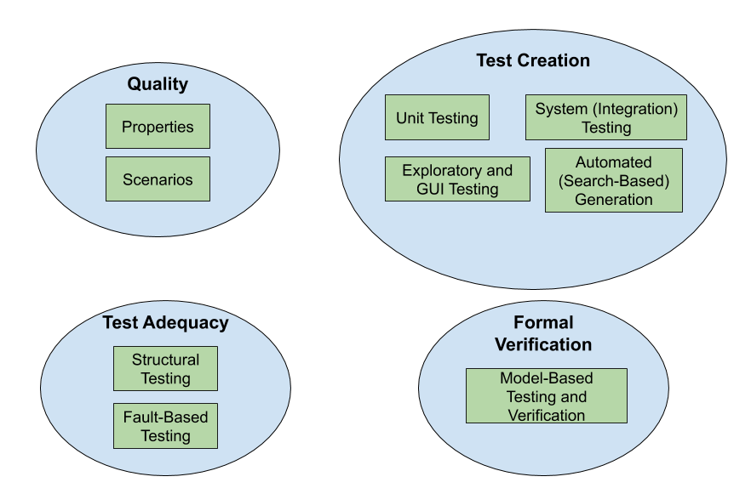
Lecture Plan (approximate)
Lectures 4 - 8, 15
Lectures 2-3
Lectures 9 - 11
Lectures 13 - 14
Notes:
read off
Quality will differ quite a bit from the rest of the class - fairly high level, why we care about this, how we assess it, some general tactics for ensuring that this form of quality is met.
Then, we dive into the process of testing, the phases of testing, and specific testing techniques (go over)

Slide 16
Changes from Last Time
Slides have been updated.
Some examples have been added or reworked.
Assignments have been updated and reworked.
Assignment 4 split in two (feedback before exams).
New case examples.
Notes:
what has changed? honestly, not a lot. Class seemed to work pretty well last time, so we’ve made some minor adjustments and updates, but should hopefully work well again this time. Biggest changes are to the assignments, especially the first, where we have reworked some of the problems

Slide 17


(Optional) Course Literature
Software Testing and Analysis, Mauro Pezze and Michal Young.
Free e-book
https://ix.cs.uoregon.edu/~michal/book/free.php
Effective Software Testing: A Developer's Guide, Maurício Aniche.
Free e-book (GU or Chalmers library)
https://www.effective-software-testing.com/
Notes:
There is no mandatory course literature. We recommend two optional text books: First is Mauro Pezze, Michal Young. Software Testing and Analysis: Process, Principles, and Techniques. Students can request a free copy of the textbook. Second is Effective Software Testing: A Developer’s Guide by Maricio Aniche. Both books provide additional material on some of the course topics and cover additional topics that we do not have time to get to in the course. Neither are required, but both will enhance your understanding of the subject. In particular, we recommend getting the first book, as it is free (and a good book on the theory behind software testing, even if a bit outdated on the tech). The second is relatively inexpensive for a physical copy or free as an e-book and provides a more modern view of some of the topics than the first book. Additional optional readings will be provided for individual topics.

Slide 18
Prerequisite Knowledge
Main language: Java.
Some code examples also in Python, C/C++, JavaScript.
Good to know:
Basic understanding of REST APIs.
Basic understanding of formal logic.
Notes:
(go over - the main language for examples will be Java, and we will be using JUnit - don’t need to know JUnit already

Slide 19


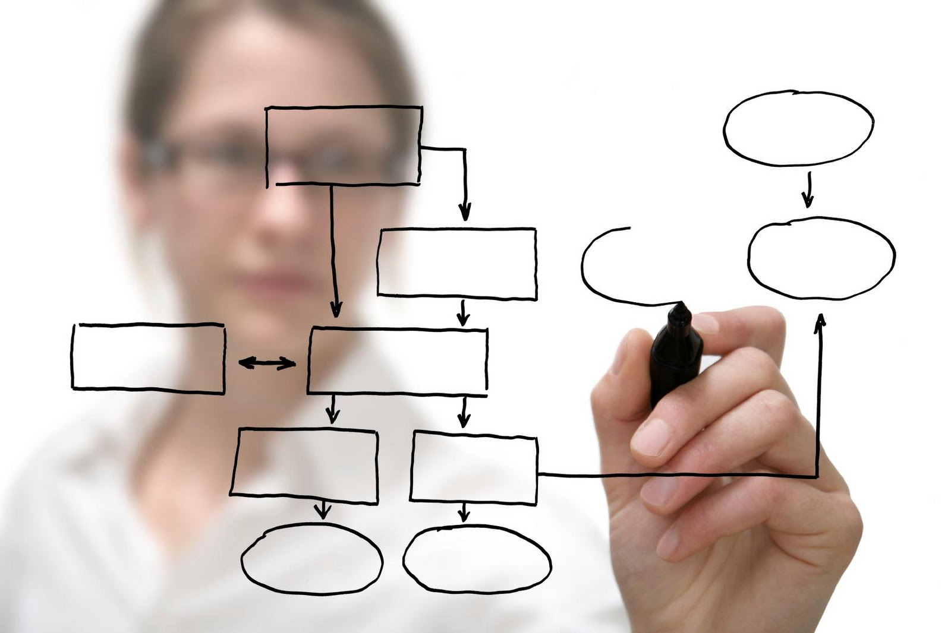
Course Design
Lectures
Exercise Sessions
Group Assignments
Notes:
- Most of the time, we’re in normal class mode. I will stand up here and drone at you, then toss in a joke to keep you awake. This is twice a week - on Tuesday, then Wednesday. Check canvas for the room, as the Wednesday lectures shift between classrooms. Attendance in the lecture is highly recommended, but not mandatory. Note that any material covered in lectures can be referred to in the project and exam (i.e., not just material written in the slides).
- Then, because it’s boring to just listen to me talk. For me too. We’ll do weekly exercise sessions. We’ll work through larger problems, try to put some of the ideas from class into practice. Get more examples to work through. We will also do small exercises during a lot of the individual class sessions. When we do these, I expect you to give them a try and volunteer answers - I’ll wait here awkwardly until you do. Anyways, Exercise sessions are also a time to get help on homework. I will be there, as will the TAs. I’ll give some introduction at the start and some explanation, then you can work on the exercise and ask questions. We can do breakout rooms with groups or just work through things as a class. This is a combination office hour and bonus explanation/problem session. Attendance in supervision sessions is, again, highly recommended but not mandatory.
- Then there will be Assignments. Work in groups of three on problem sets. Another step up in complexity from the exercise sessions. Think of this as theory in lectures, to hands-on problems in exercises, to practice in assignments.

Slide 20
Examination Form
Sub-Courses
Written examination (Skriftlig tentamen), 4.5 higher education credits
Assignments (Inlämningsuppgifter), 3 higher education credits
Grading scale: Fail (U), 3-5

Slide 21
Assessment
Individual hall exam at end of course
Written assignments in teams of three.
You may choose your own team.
See Assignment 0 on Canvas. Due Sunday.
Five written assignments.
Equally weighted.
Module grade is average of assignment grades.
Notes:
The course is examined by an individual written exam carried out in an examination hall at the end of course and written assignments normally carried out in groups of three students. The assignments part is examined on the basis of solutions to compulsory problems handed in during the course and on the basis of individual contribution to the group work. There will be four group written assignments. Each assignment is equally weighted. Specific requirements for the assignments will be provided on Canvas.The final grade for the assignment part of the course (3 credits) will be an average of the grade for each of the three assignments. If the average grade across the assignments is passing, the students will receive a passing grade for the assignment part of the course. Failing one of three assignments does not necessarily mean there will be a failing grade for the assignments part of the course.

Slide 22
Assessment
Self and peer-evaluation due with each assignment
May be used to adjust individual assignment grades.
AKA: don’t slack off!
Late assignments, -20% per day, 0% after two days
If final assignment average is failing, all assignments must be redone/resubmitted.
Notes:
Students are required to complete written self- and peer-assessment forms during the course which will be part of the assessment of the student's individual contribution to the project. The instructor may adjust the individual grades of a student depending on this evaluation. Note that although the grade is given for a group assignment, this grade is then assigned individually to students, and may be adjusted depending on the peer evaluation form. Thus, not all students in the same group are guaranteed to get the same grade. Such situations are rare.
(4)If the final average grade of all assignments is a failing grade, all three assignments must redone and resubmitted with a new case. The redone assignments are handed in again at a date after course completion. A new case will be provided. Redone assignments can be done in groups or individually.

Slide 23
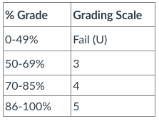
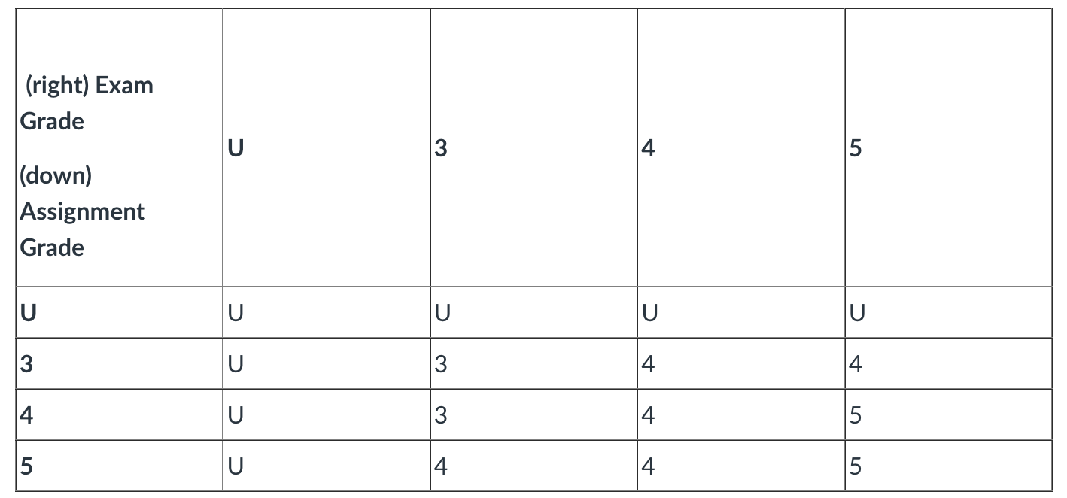
Grading Scale
Score of 1-100, converted to Fail, 3-5:
Final course grade:
Notes:
The grading scale is the same for both assignments and the exam. Fail, then 3-5. Both written assignments and the final exam will be graded on a numeric scale, converted to a final grade . The final percentage grade for the assignments and exams will be converted as follows (table 1). Then, your final course grade can be found from this table (go over)

Slide 24
Expected Workload
This class can be time consuming.
Understanding the material takes time.
Project work requires team coordination.
Do not underestimate the assignments.
Good engineering is hard.
Planning and scheduling your time is essential.
Do NOT delay getting started.
Appoint a team leader (and rotate the role)
Notes:
project -
We’re not trying to make things arbitrairly hard to justify teamworks, but good engineering is hard - it takes time adn work
planning/scheduling is essential. most issues come from people starting too late and trying to cram. That doesn’t work here. Especially given the need for teamwork. Working together takes planning.
You can’t slack off - we do use peer evaluations in grading, and if you don’t take part, you won’t get the grade.
Team leader (read)

Slide 25
Other Policies
Integrity and Ethics:
Work you submit must be your own.
Generative AI: Can be used to brainstorm, summarize concepts, fix grammar, generate plots (i.e., to support learning), but all text and code must be written by YOU.
If you want to use GenAI, ask me first, disclose in submission.
Collaboration is not permitted on assignments.
Violation = failing grade and reporting.
Notes:
The homework and programs you submit for this class must be entirely your own. If this policy is not absolutely clear, then please contact me. Any other collaboration of any type on any assignment is not permitted. It is also your responsibility to protect your work from unauthorized access. Any violation of this policy will result - at minimum - in a failing grade on the assignment. Further infractions will result in a failing grade in the course and further disciplinary action. Generative AI tools (e.g., ChatGPT, Mistral, DALL-E) may be used to support your learning (e.g., to help you understand concepts or brainstorm). However, all code, text, or other material you submit in assignments must be your own original work. You may not submit generated test cases or scenarios as your own. You must create your own content in assignments. You may use ChatGPT to improve your grammar (i.e., in a form similar to tools like Grammarly), but you must write all text yourself initially. You may use Generative AI to generate plots or images, based on data that you gathered or provided yourself. If you plan to use Generative AI in an assignment: Ask the teacher first! Disclose in the assignment which tools you used and how you used them. Bear in mind that the answers provided by Generative AI tools may not be correct. Perform your own evaluation of the output of these tools. We reserve the right to use AI detection tools to check assignments for plagiarism.

Slide 26
Other Policies
Classroom Climate:
Arrive on time, don’t talk during lecture unless part of class discussion. Disruptive students will be warned and dismissed.
Diversity
Students in this class are expected to work with all other students, regardless of gender, race, sexuality, religion, etc. Zero-tolerance policy for discrimination.
Special Needs
We will provide reasonable accommodations to students that have special needs. Contact teaching team early to discuss individual needs.
Notes:
(climate) All students are expected to behave as scholars at a leading institute of technology. This includes arriving on time, not talking during lecture (unless addressing the instructor), and not causing disruption in the classroom chat - only use it to ask or answer questions. Disruptive students will be warned and potentially dismissed from lectures.
(diversity) Someday you will graduate, and in the real world, you will have to work with a wide variety of people. Now is the time to abandon preconceived prejudices about others. Students in this class are expected to respectfully work with all other students, regardless of gender, race, sexuality, religion, or any other criteria. There is a zero-tolerance policy for any student that discriminates against other students for any reason.
(needs) It is university policy to provide, on a flexible and individual basis, reasonable accommodations to students that have disabilities that may affect their ability to participate in course activities or to meet course requirements. Students with disabilities are encouraged to contact their instructor early in the semester to discuss their individual needs for accommodations.

Slide 27
Let’s take a break!
Notes:
Just start with a question - want you to start thinking about this. (read)
This isn’t something with one answer, or even a right answer. It’s something we’ll keep returning to

Slide 28
When is software ready for release?
Notes:
let’s see what you wrote and talk a little about it (go to mentimeter and look over answers)

Slide 29
The short (and not so simple) answers...
We release when we can’t find any bugs…
We release when we have finished testing…
We release when quality is high...
Notes:
(go over these)
1 - how do you know there aren’t any we haven’t discovered?
2- How do we know we’re done?
3 - What does that mean? What is quality to you? When is it high?
We are inching there with the last one, but that’s a loaded question too.

Slide 30
“When Quality is High?”
What does quality mean?
How do we measure quality?
What is “enough” quality?
How do we assess quality at a single point in time and over the project lifespan?
Notes:
There are a lot of questions buried in this question. What does quality mean? How do we measure quality? What is “enough” quality? How do we assess quality at a single point in time and over time?

Slide 31
Software Quality
We all want high-quality software.
We don’t all agree on the definition of quality.
Quality encompasses what and how.
How dependable it is.
But also…
How quickly it runs.
How available its services are.
How easily it scales to more users.
Hard to measure and assess objectively.
Notes:
We all want high-quality software, we all agree that quality is necessary. However, we don’t all agree on what quality means. Ask ten people, and they may describe ten things. Why? (3) what a system does and how it does it. what a system does is only part of the story and that how the system provides its services often has a huge impact on the perceptions that stakeholders have of it. (rest)

Slide 32
Quality Attributes
Describe desired properties of the system.
Developers prioritize attributes and design system that meets chosen thresholds.
Most relevant for this course: dependability
Ability to consistently offer correct functionality, even under unforeseen or unsafe conditions.
Notes:
Quality attributes describe desired properties of the system under development. Developers must prioritize quality attributes and design a system that meets chosen thresholds.
Most relevant for this course: dependability. Ability of the system to consistently offer correct functionality, even under unforeseen or unsafe conditions.

Slide 33
Quality Attributes
Availability
Ability to carry out a task when needed, to minimize “downtime”, and to recover from failures.
Performance
Ability to meet timing requirements. When events occur, the system must respond quickly.
Scalability
Ability to maintain dependability and performance as the number of concurrent requests grows.
Notes:
Here are other ways we assess quality

Slide 34
Quality Attributes
Security
Ability to protect information from unauthorized access while providing service to authorized users.
Modifiability
Ability to enhance software by fixing issues, adding features, and adapting to new environments.
Testability
Ability to easily identify faults in a system.
Probability that a fault will result in a visible failure.
Notes:
- (2)
- (4)
- (6) a well-designed system is able to amplify a failure - ensuring that you notice problems, rather than getting subtlely wrong answers or missing issues until it is too late. For instance, the system design can determine what information is visible for inspection when testing, and a system could be designed to surface information to a special testing interface designed to provide data that would not otherwise be visible to the world.

Slide 35
Quality Attributes
Interoperability
Ability to exchange information with and provide functionality to other systems.
Usability
Ability to enable users to perform tasks and provide support to users.
How easy it is to use the system, learn features, adapt to meet user needs, and increase confidence and satisfaction in usage.
Notes:
- (2) This is not useful in isolation, but is defined by context - by identifying with whom, what, and under what circumstances the system is supposed to communicate and work with .The idea here, however, is that the architecture is designed to provide the right data and functionality to external sources in a controlled manner.
(4-5) Naturally, this most centrally relates to user interfaces, but impacts the entire architecture and how users work with it.

Slide 36
Other Quality Attributes
Environmental Sustainability
Ability to operate with a minimal carbon footprint.
Minimal energy consumption.
Ability to execute operations in locations with high renewable energy resources.
Portability
Ability to translate the system to new hardware and software platforms.

Slide 37
Quality Attributes
These qualities often conflict.
Architecture with few components: improved performance, but lower maintainability.
Redundant data helps availability, but lessens security.
Encryption increases security, but lowers performance.
Important to decide what is important, and set a threshold on when it is “good enough”.
Notes:
Now, unfortuantely, emphasizing one of these qualities tends to lessen another quality. They conflict with each other. It is hard to achieve multiple qualities at once. Using a small number of components in your architecuter improves performance because there are fewer communication overheads, but hurts maintainability, as it’s harder to add features or make changes to complex components. Redundant data helps availability, but lessens security.- you need to protect all of that data equally, and that’s infinitely harder than protecting data in one place. Encryption increases security, but lowers performance, as you need to perform decryption operations.
(last point), we’ll talk more about that over the next three classes

Slide 38
When is Software Ready for Release?
Software is ready for release when you can argue that it shows sufficient quality.
Requires choosing quality attributes.
Requires specifying measurements and thresholds.
May require different measurements and thresholds for different functionality and execution scenarios.
Assessed through Verification and Validation.
Notes:
So, back to the question… the first crack we’ll take at an answer - and you’ll see pretty soon why this is so complicated - is that (read).
The primary process of d providing evidence of software quality is Verification and Validation.

Slide 39
Verification and Validation
Activities that must be performed to consider the software “done.”
Verification: Proving that software conforms to its functional and non-functional requirements.
Validation: Proving that software meets customer’s true requirements, needs, and expectations.
Notes:
Verification and validation are two essential activities (read)
These sound similar, but they’re a little different.

Slide 40
Verification and Validation
Barry Boehm:
Verification:
“Are we building the product right?”
Validation:
“Are we building the right product?”
Notes:
Barry Boehm - the guy who invented the term and what we think of as the practice of “software engineering” today - came up with the most succinct definitions of each. (read)

Slide 41
Verification
Is the implementation correct?
Judged by asking: “Is the implementation consistent with its specification?”
Verification is an experiment.
Perform trials, evaluate results, gather evidence.
Notes:
Verification asks if (1). (2)In other words, according to our expectations, does it do what we expect? Usually, at the beginning of a project, we lay out a set of requirement specifications. We state the set of properties that define how the software’s functionality will work. What defines correct behavior? What equations are used? What properties must not be violated? Then, once we build the code, we want to go back and see if the code meets these properties. If it doesn’t, then the code is wrong - whether it crashes or not, it doesn’t do what it was supposed to do. So, verification is how we argue that the software meets its specification. It is an empirical activity - an experiment we can conduct. We can perform trials, evaluate the software, and provide evidence for verification.

Slide 42
Verification
Is an implementation consistent with a specification?
“Specification” and “implementation” are roles.
Usually “source code” and “requirement specification”.
But also…
Source code and architectural design.
Architectural design and requirements.
Test cases and requirements.
Source code and user manuals.
Notes:
That said (2) verification is a check of consistency between a description and its realization. (3). The code is a realization of the requirements, and we check that the code does what the requirements promised. However, veriication is an actibity we perform constantly throughout the development process, and can be between any realization or implementation and its specification. We also perform verification to make sure that (last four). Mostly, however, when we talk about this, we are talking about performing trials to see if the software we built does what the requirments promised it would do.

Slide 43

How do we know an implementation is correct?
Rationalists
Empiricists
“It is correct because I proved that certain errors do not exist in the system.”
“It is correct because I never observed incorrect behaviors.”
Adapted from Shin Yoo (KAIST)
Notes:
(title) We can ask the rationalists - the philosophers - and the empiricists - the experimenters. The rationalist would say that (read), while the empiricists would suggest (read). These two sides lead to the two primary families of verification techniques - what we call static and dynamic verification.

Slide 44

Static Verification
Analysis of code and other development artifacts.
Proofs: Posing hypotheses and making arguments using specifications, models, etc.
Inspections: Manual “sanity check” on artifacts (e.g., source code), searching for issues.
“It is correct because I proved that certain errors do not exist in the system.”
Notes:
Static verification is (1). So, it’s the process of inspecting the artifacts produced during development - the requirements, specifications, design documents, source code to find issues, to make formal arguments for correctness. This analysis can be done by tools or people. A couple common forms of static verification include
(2), We will see some of that later in the study period, where we will prove properties over models that represent the code. (3) Static verification can be very effective, and more importantly, does not require working code to perform. PArts of the code, or requirements, or models can be analyzed without running the system.

Slide 45
Advantages of Static Verification
Proofs offer conclusive evidence of problems.
One error can hide other errors. Inspections not impacted by program interactions.
Incomplete systems can be inspected.
Code inspections can assess subjective quality attributes (maintainability, portability, usability).
Notes:
Proofs, when possible, offer conclusive evidence of certain problems. Dynamic techniques are never conclusive. Second, During execution, errors can hide other errors. Hard to trace a failure back to a single source. Inspections not impacted by program interactions. you can analzye pieces of the code in isolation and look for issues.
Incomplete systems can be inspected without additional costs. If a program is incomplete, and you need to run parts of it, special code is needed to run the part that is to be tested. Inspection can also assess subjectve quality attributes such as maintainability, portability, or usability..

Slide 46

Dynamic Verification
Exercising and observing the system.
Testing: Executing input and checking whether the resulting output meets expectations.
Fuzzing: Generating semi-random input to detect crashes, memory leaks, buffer overflows, etc.
Taint Analysis: Monitoring how corrupted data spreads through system.
“It is correct because I never observed incorrect behaviors.”
Notes:
Dynamic verification, on the other hand, involves the running and observing the system. Dynamic verification takes many forms, but the central one is testing. Testing is the primary form of dynamic verification, and - by far - the most common means of determining whether software works correctly and obeys all constraints we set on it.
Software testing is fundamentally an investigation where we provide stimuli to the system - some form of input - and we take the output and observations of the execution, then compare those observations to a set of expectations on what should be happening. We then issue a verdict - Pass if everything matched, fail if it did not. Testing will be our main focus, but we will touch some on other forms of verification in this course. Some other forms of dynamic verification include (go over fuzzing and taint analysis).

Slide 47
Advantages of Dynamic Verification
Discovers problems from runtime interaction, timing problems, or performance issues.
Cheaper, more scalable than static verification.
Much easier to achieve volume.
Works on much more complex systems.
However, cannot prove that properties are met
Cannot try all possible executions.
Notes:
Static verification is not good at discovering problems that arise from runtime interaction between different processes or objects, timing problems, or performance issues. Often, you need to actually run the code to see those problems emerge.
More importantly, Dynamic verification is much cheaper than static verification and scales much better to larger and more complex systems. Proofs are only possible when we can check for all possible outcomes, limiting the types of analyses we can do or the types of systems we can inspect. Dynamic verification can always be used, on any system. This is why testing is king - why it is so common. However, it cannot prove that properties are met - cannot try all possible executions. Static verification can be limited, but when it works, it can be more conclusive.

Slide 48
The Trade-Off
Static Analysis:
Overapproximation
Naive analysis:
There is a division-by-zero error here.
Not being naive is expensive.
Dynamic Analysis:
Underapproximation
Only detect faults if we select the right input. def test_bar(): assert bar(42) == 1
def foo(n):
if n > 0:
print(bar(n))
else:
return
def bar(a):
return 42 / a
Adapted from Shin Yoo (KAIST)
Notes:
No form of verification is perfect. We cannot prove that all programs are absolutely correct or or absolutely incorrect. There is an inherent trade-off between these techniques. Inherently, static analysis is an overapproximation, while dynamic analysis is an underapproximation.In this code, If a is 0, bar will divide 42 by 0. A naive static analysis would say there is a division by zero error in this code. Full stop. There’s a problem, fix it. However, if we look at it. It’s only a problem sometimes, right? However, a naive analysis would raise alarms. Not being naive is expensive. Being more specific requires a much more complex analysis that will (if we’re lucky) take a long time, or (if unlucky) won’t scale to complex code and will only work in limited circumstances. That’s the limitation of static analysis - it’s generally an overapproximation that can tell you there are problems when there aren’t. On the other hand, dynamic analysis is an underapproximation. We will only detect a problem if we select the right input. We might have just written one test (go over). If we don’t have a test where we try 0 as an input, we will miss the problem. We’ve only made a partial observation of the potentially massive space of possible inputs. Dynamic verification can easily tell you the program is correct when it isn’t.

Slide 49
Validation
Does the product work in the real world?
Does the software fulfill the users’ actual needs?
Not the same as conforming to a specification.
If we specify two buttons and implement all behaviors related to those buttons, we can achieve verification.
If the user expected a third button, we failed validation.
Notes:
Moving on to validation, Validation asks a broader question - (read 1-2), their real requirements.
(3). A specification is one view of how to solve a problem. The trouble is that solution might not actually achieve the goals that the users want fulfilled. (read 4-5) The software works, under the conditions we set. We can argue that with no problem. That said, it doesn’t do what the users actually want, so we didn’t build the right software.

Slide 50
Verification and Validation
Verification
Does the software work as intended?
Shows that software is “high quality”.
Validation
Does the software meet the needs of your users?
Shows that software is actually useful.
This is much harder.
Notes:
(read 1-4) talk about people
The point of both verification and validation is ensuring that the software we’re building works. If it doesn’t, we’ve wasted our time, we’re trying to sell a product no one wants or can use.
Ultimately, the point of both is to answer the big, nebulous question of whether the software is correct and ready for release, but at two different scopes.
Validation shows that software is useful. Verification shows that it is dependable. Both are needed to be ready for release.

Slide 51
Verification and Validation
Both are important.
A well-verified system might not meet the user’s needs.
A system can’t meet the user’s needs unless it is well-constructed.
This class largely focuses on verification.
Testing is the primary activity of verification.
Notes:
Both are extremely important, and they are closely linked. (2). You could have had a misunderstanding, the customer might not have told you everything
But, (3). Without verification, you’re likely to have missed faults or requirements mistakes. You’ll never meet their needs to the degree that is required if you don’t start from a solid base.
You can’t build a successful, robust system without both. Verification and validation is about making an argument that you’ve built the best solution for the job. Validation is somewhat subjective, as it involves people - but being able to argue that your software meets their needs is a good start to making the validation case. Verification gives you the evidence to make that argument. Verification is not as subjective. It can be conducted poorly, but you have an experimental setup with well defined operating conditions. It is only subjective in the sense that your requirements are YOUR view of the problem. You can prove that the implementation meets its specification, and you can use that as the basis for validation - you can offer some assurance that you didn’t screw up. Under these conditions, the system does exactly what we promised it would do. So, both come hand-in-hand in determining the success of your project. (4) How can we ensure that the software we build is dependable.Testing is the primary activity of verification, and our main focus in this class.

Slide 52
Basic Questions
When do verification and validation start and end?
How do we obtain acceptable quality at an acceptable cost?
How can we assess readiness for release?
How can we control quality of successive releases?
How can the development process be improved to make verification more effective?
Notes:
So, as an engineer who wants to build a robust piece of software, you need to sit down at the start and answer five basic questions. Those answers will guide the entire V&V process, and by the time this class is over, you will be able to answer these questions like experts. When do verification and validation start? When are they complete?
What techniques should be applied to obtain acceptable quality at an acceptable cost?
How can we assess readiness for release?
How can we control the quality of successive releases?
How can the development process be improved to make verification more effective (in cost and impact)?

Slide 53
When Does V&V Start?
V&V can start as soon as the project starts.
Feasibility studies must consider quality assessment.
Requirements can be used to derive test cases.
Design can be verified against requirements.
Code can be verified against design and requirements.
Feedback can be sought from stakeholders at any time.
Notes:
(read all)
Quality and dependability must be part of every phase of design. Verification is not just about the running source code, but must be used to check each stage of design and development.

Slide 54
How Can We Assess Readiness?
Must decide when to stop V&V.
Need to establish criteria for acceptance.
How good is “good enough”?
Measure quality and set threshold to meet.
Measurements for each chosen attribute.
Measure during select scenarios.
Notes:
Most of the things we cover in this class are done with the goal of identifying, locating, or removing faults, and that’s obviously something useful. But, finding all faults is a pipe dream. It’s nearly impossible, and definitely not cost effective. Verification can’t go on forever. So, at some point, we need to make a judgement call - is this ready to go. You need to be able to make that call, and to do so, you need a plan in place. (read 2 -3) Now, one option is to measure the level of quality - there are measurements that can be used for each quality attribute such as the uptime or the mean time between failues or larency. We will cover these more later. But, you can track these measurements throughout development, simulate the use of the system, take down figures, and declare the system ready once that threshold is met. That threshold might be situational, but you can assess differently for a set of chosen situations.

Slide 55
Product Readiness
Alternative: Put it in the hands of human users.
Alpha/Beta Testing
Users report feedback and failures.
Dependability measurements give quantitative data.
Opinion surveys give qualitative data (e.g.,usability, bias).
Notes:
Another option is to (1). This is almost always a good idea at some point - people will find ways to break your software that you never imagined. So, at some point, you want to start brining in those users. First, with alpha testing, where a tiny group of select people are given access to the software in a controlled environment, observed by the developers. Then in beta testing, an even larger crowd gets their hands on the product in their own operating environment, without interference or close monitoring from the developers. At both stages, you can perform quantitative studies of the software dependability, measuring those reliability metrics, of course, but You can also perform qualitative analysis by surveying the users and their opinions - asking them if they actualyl like the software.(are the users happy with the current product?) This enables assessment of more subjective or hard to measure criteria like usability or whether biases exist.

Slide 56
Required Level of V&V
Depends on:
Software Purpose: The more critical, the more important that it is reliable.
User Expectations: Users may tolerate bugs because benefits outweigh cost of failure recovery.
Marketing Environment: Competing products - features and cost - and speed to market.
Notes:
The ultimate goal of verification and validation processes it to establish confidence that the software system is “fit for purpose”, it’s good enough for its intended use and ready to ship. The level of required confidence depends on the system’s purpose, the expectations of the system users, and the current marketing environment for the system
Software Purpose: The more critical the software, the more important that it is reliable.This means that the V&V process is stricter the more serious the consequences of something going wrong. V&V is easy for a to-do list - bugs won’t cause trouble. It’s harder for a web store, since money can be lost. It’s even harder for a medical device, since people can be hurt. User Expectations: When a new system is installed, how willing are users to tolerate bugs because benefits outweigh cost of failure recovery? They still expect the software to become more reliable as the system matures, and failure to increase reliability can be costly. However, you may be able to get away with less V&V initially.
Marketing Environment: Must take into account competing products - features and cost - and speed to market. Those weigh heavily into the calculation of how much time and effort to spend on V&V

Slide 57
Ensuring Quality of Successive Releases
V&V do not end with release.
New features, environmental adaptations, bug fixes.
Test new code, retest old code, track changes.
When code changes, rerun tests to ensure old code works.
Retain tests that exposed faults to ensure they do not return.
Notes:
(1) Software evolves, (2)

Slide 58
Improving the Development Process
Try to learn from your mistakes in the next project.
Collect data during development.
Fault information, bug reports, project metrics (complexity, # classes, # lines of code, test coverage, etc.).
Classify faults into categories.
Look for common mistakes.
Learn how to avoid such mistakes.
Share information within your organization.
Notes:
Finally, that last question to keep in mind is how the development process can be improved as a result of verification and validation -aka: learn from your history and don’t make the same mistakes over again.
(read)

Slide 59
We Have Learned
Determining “ready to release” requires software to meet quality goals.
Quality attributes describe desired properties.
Dependability, scalability, performance, availability, security, maintainability, testability, ...
Must prioritize quality attributes and design a system that meets chosen thresholds for each.

Slide 60
We Have Learned
Software should be “high quality” and useful before it is released into the world.
Verification demonstrates that an implementation meets its specification.
This is the primary means of demonstrating that software is “high quality” .
Testing is most common form of verification.
Notes:
the third feature we would like is completeness.
(read) - that is, for all programs that do satisfy the property, you get a true back. This is like soundness. In soundness, if you get a true, that means it is true - you can’t get a true when it is actually false. Here, you can’t get a false if the property is true.if you get a false, it must be false.
(read) You can get incorrect true verdicts, but not incorrect false verdicts.
(read)

Slide 61
Next Time
Measuring and assessing quality.
No exercise session this week.
Plan your team selection.
The earlier, the better! Due January 25, 23:59.
See Assignment 0 on Canvas.

